Slide 1
As-Salamualikum
Project Name:
“Student Association Fund Management System”
Project Supervisor:
Dr. Mrinal Kanti Baowaly
Assistant Professor,
Department Of CSE
BSMRSTU
Submitted by:
Md Sharifuzzaman Shajib
ID: 18CSE032
Department Of CSE
BSMRSTU

Slide 2
Presentation Outline
1.Introduction
2. The process of my project
3. Using Language & tools
4. Advantage
5.Limitation
6.Future Plan

Slide 3
“
Introduction:
The name of my project is “Student Association Fund Management System”. It is a desktop application. Fund Management System is a simple yet powerful one joint integrated platform that manage the entire operations of fund management of an Association. By this project an admin can easily maintained their fund. It enabled the user to store, modify, manipulate and retrieve information using select menus of the students of an Association. Student Association Fund Management System is also a utilitarian tool which enables the user to access all the opened ID fro details like as date of birth, hometown, phone-number, student id no etc.
“

Slide 4
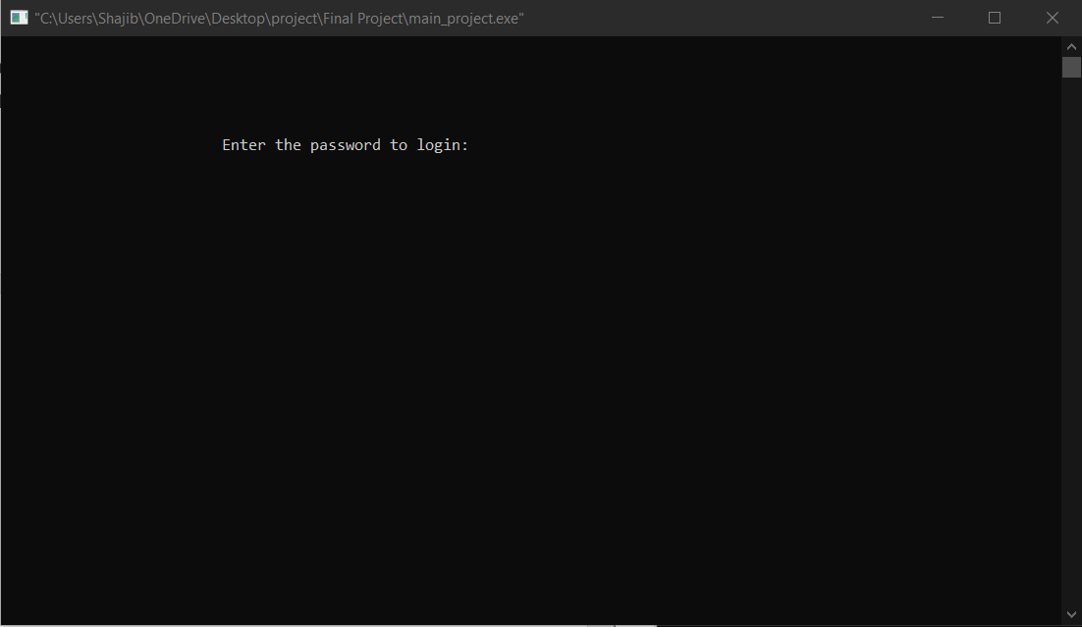
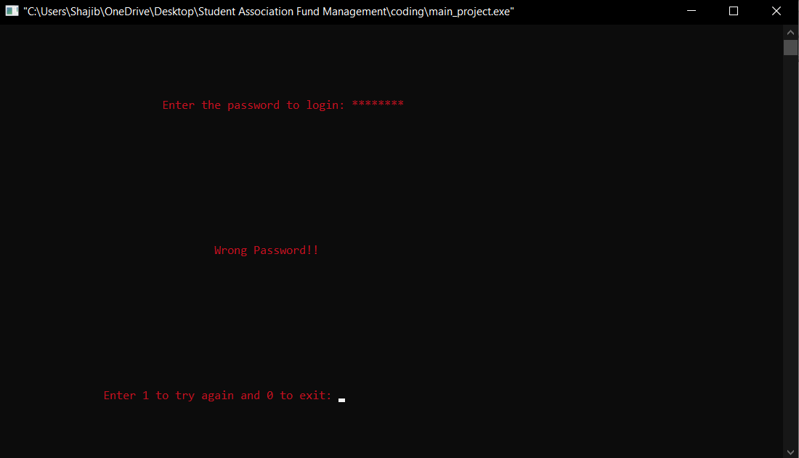
Login Page:
If the password is wrong:

Slide 5
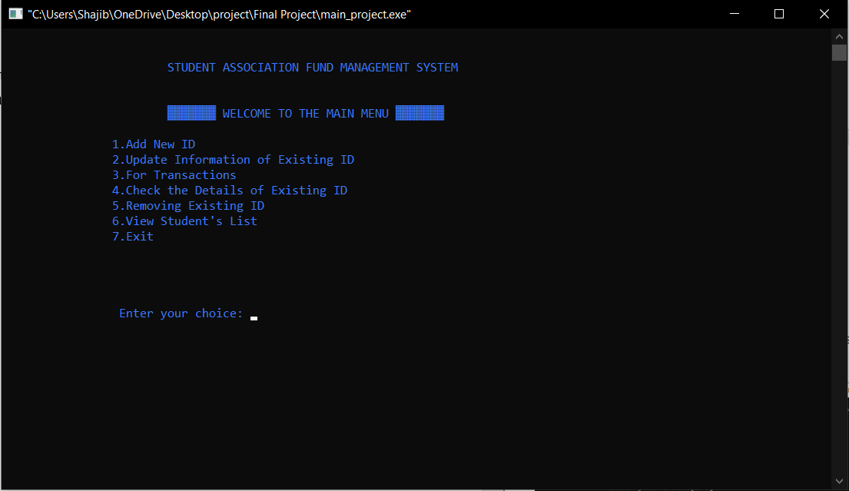
This is Home Page

Slide 6
Which Language and tools I used
Language
C Programming Language
For Coding
For making video
For Coding I only used codeblocks
For making video I used “fast stone capture”

Slide 7
Advantage
Add New Student
Check the Details of Existing ID
Edit Existing ID
Remove Existing ID
Transaction
View Student List

Slide 8
Limitation
01
Windows
02
Name without Spacing
03
Not Clickable
04
Not Responsive

Slide 9
Future Plan
01
Developed by High level Language
02
Hole device frankly
User Interface Developed
03
04
Android Application

Slide 10
Thank you

